Slide 1
What is Internet…?

Slide 2
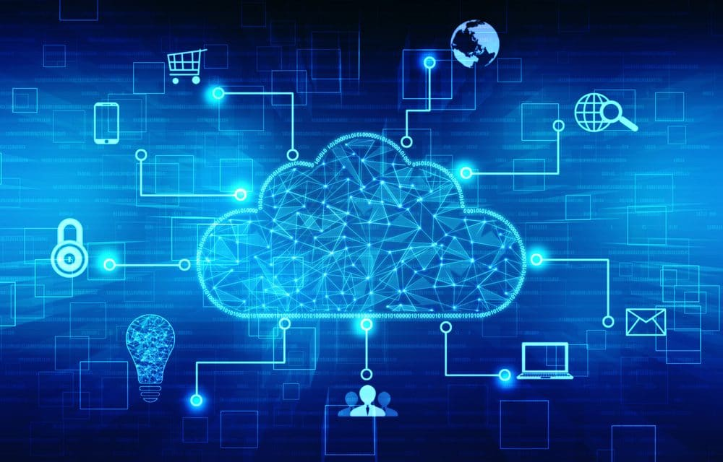
Internet is a global wide area network that connects computer systems across the world.
Internet is a collection of computers that share information.
Internet Service Provider (ISP) connects the home user to
other computers.
Files that are transfered over Internet are called Web pages
Internet is an increasingly important part of everyday life for people around the world

Slide 3
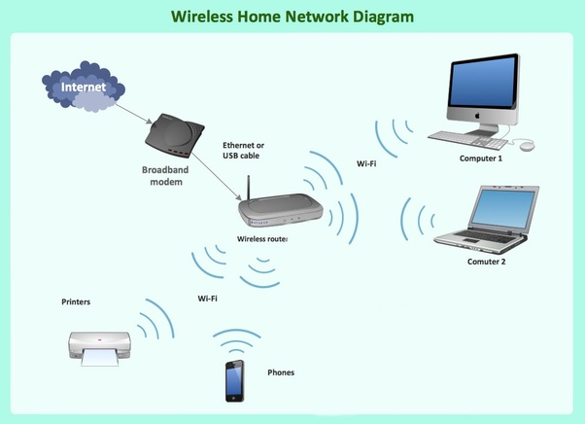
Ways To Connect To Internet
Dial-Up
Broadband
Wireless Connection
Wi-fi
Mobile Phones
Satellite
Integrated Services Digital Network

Slide 4
Advantages of internet
Easy Access to Information
Platform for Online Education
Job Hunting
Platform to become an Entrepreneur
Visual and Graphical Representation of Things
Reduced the parameter of Distance

Slide 5
Disadvantages of Internet
Dependency
Cyber Crime
Distraction
Bullying and Trolls

